Slide 1
Intro to Java Programming

Slide 2
What is Java?
Object Oriented Programming Language
Classes are at the heart of OOP
Class is made of methods and attributes
Group of classes are combined into a package
Source code is written in .java files and compiled into bytecode (.class files)
Bytecode will run on any machine which has the Java virtual machine
Java is a “write-once, run-anywhere” language
Notes:
Packages

Slide 3
Getting Set Up
Download JDK 8 https://www.oracle.com/technetwork/java/javase/downloads/jdk8-downloads-2133151.html (Google JDK 8 and download from Oracle)
Download an IDE (Integrated development environment)
We will use IntelliJ https://www.jetbrains.com/idea/download/
Download the community edition

Slide 4
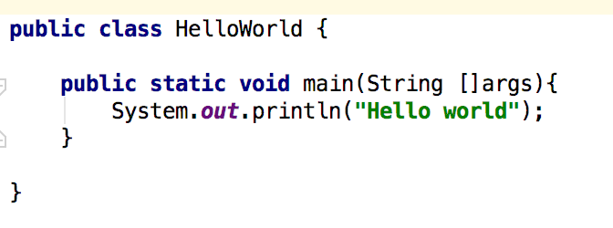
Hello World

Slide 5
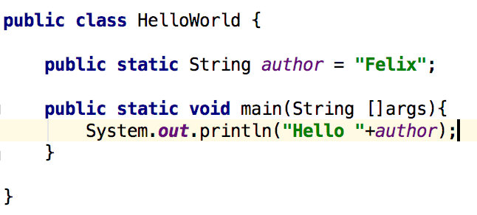
Variables

Slide 6
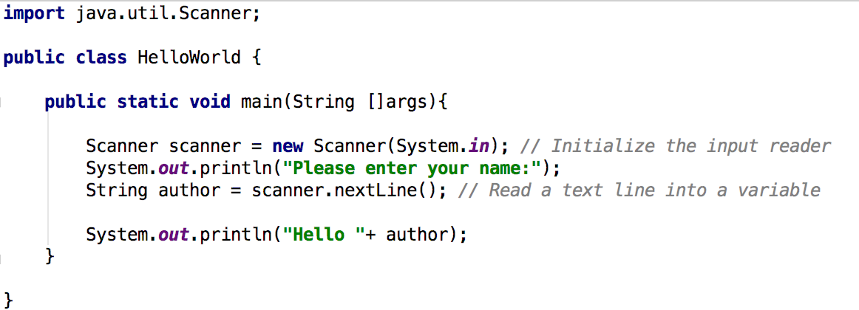
Input

Slide 7
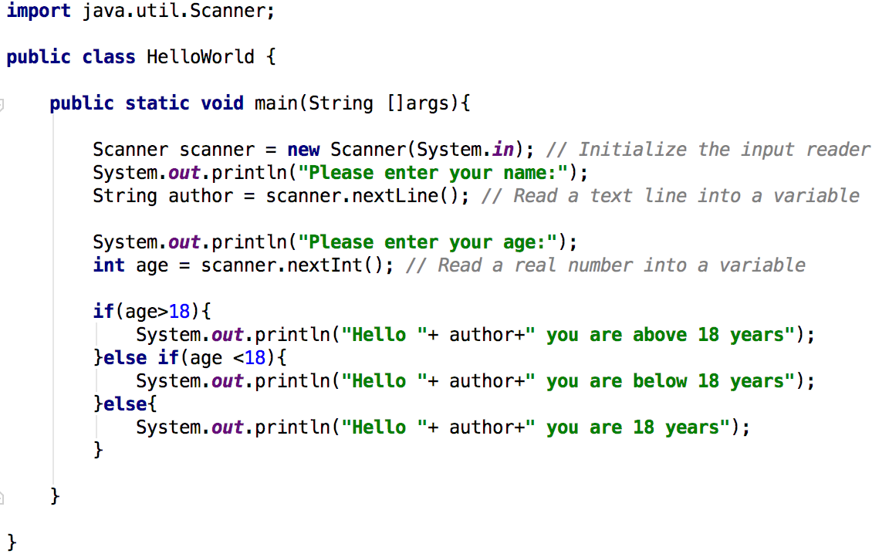
Control Structures : Conditions
> greater than
>= greater or equals to
< less than
<= less or equals to
== equals to
!= not equals to

Slide 8
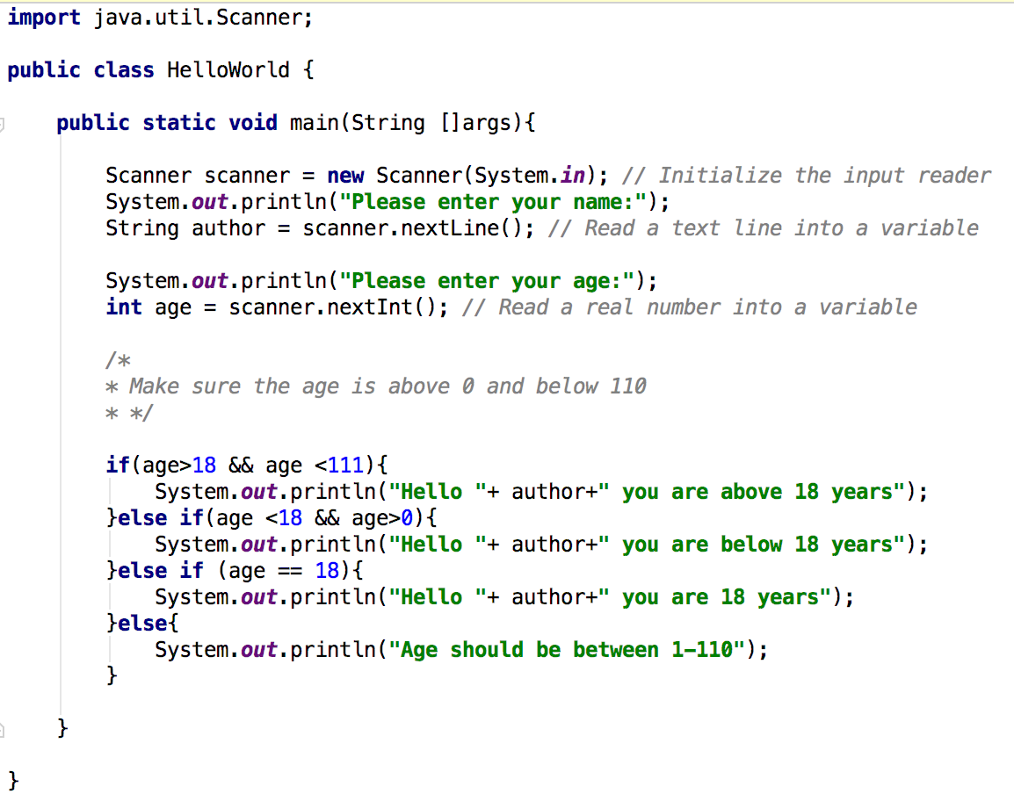
Control Structures : Logical Operators
&& logical and
|| logical or
! logical not

Slide 9
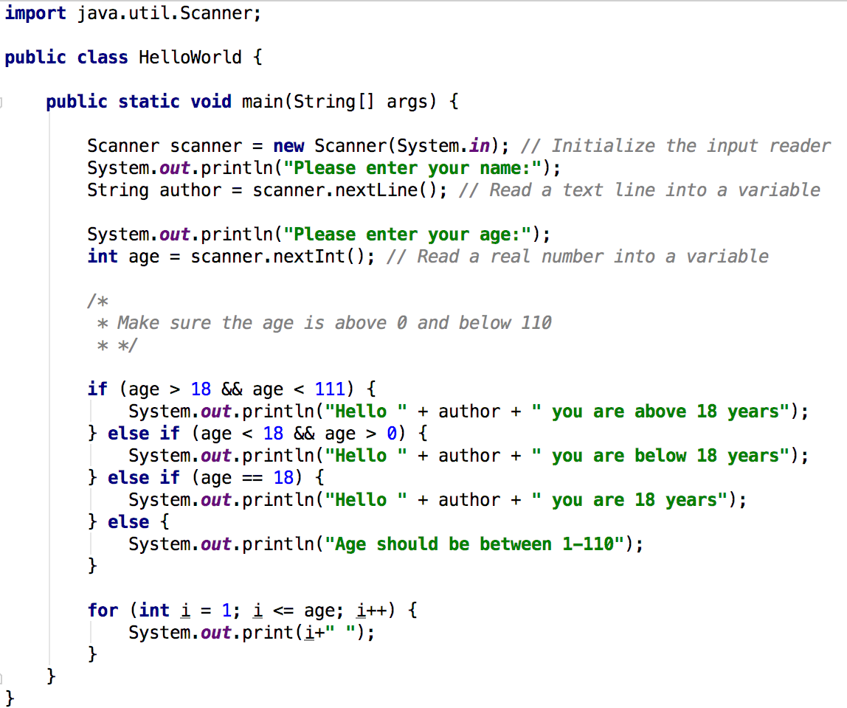
Control Structures : Loops

Slide 10
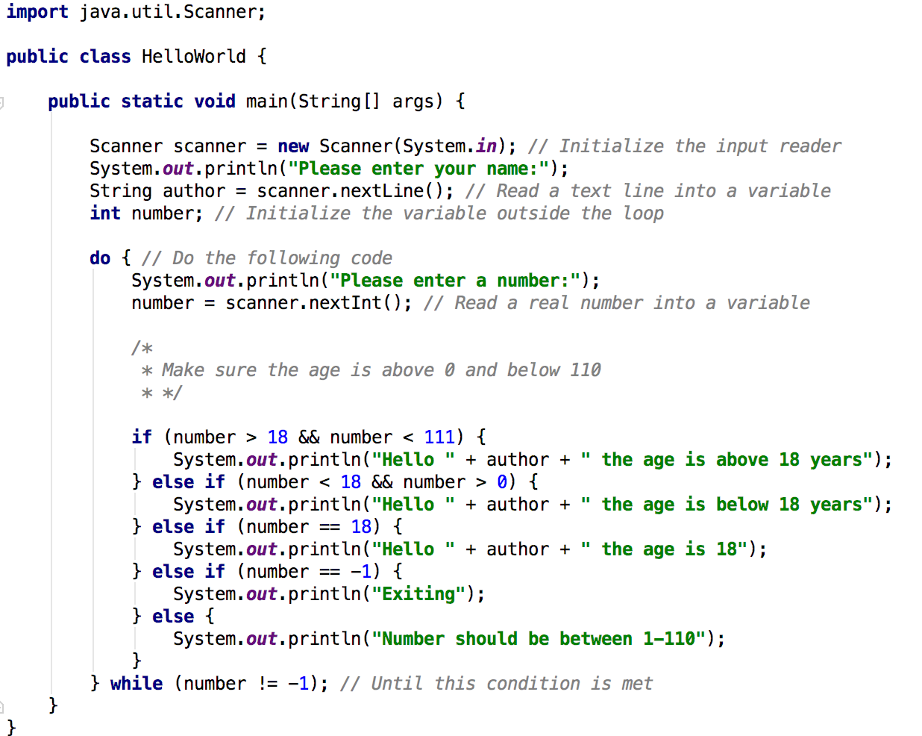
Control Structures : Loops

